Slide 1

Monitoring Humidity and Temperature using Bluetooth and WIFI module via Android device.
BS PROJECT
Bhargav Petla (18070)

Slide 2
Motivation
1. Environmental changing conditions
Alerting of any changes to the climate conditions
2. Industrial use
Measurement and maintaining constant temperature are also important in industrial processes.
3. Temperature transducers
which are used in electrical measurements are numerous due to a wide range of temperatures being measured, and because of the measurement accuracy in a specific area

Slide 3
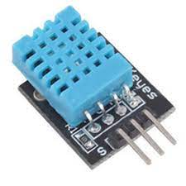
DHT 11
DHT11 Temperature & Humidity Sensor features a temperature & humidity sensor complex with a calibrated digital signal output. By using the exclusive digital-signal-acquisition technique and temperature & humidity sensing technology, it ensures high reliability and excellent long-term stability.

Slide 4
DHT 11
The DHT11 contains a surface mounted NTC thermistor and a resistive humidity sensor. An IC on the back of the module converts the resistance measurements from the thermistor and humidity sensor into digital outputs of degrees Celsius and Relative Humidity. These sensors are frequently used in remote weather stations, soil monitors, and home environment control systems.

Slide 5
DHT 11
• Ultra low cost and low power consumption.
• 3 to 5V power and I/O
• Inline digital output.
• Good for 20–80% humidity readings with 5% accuracy
• Good for 0–50°C temperature readings ±2°C accuracy
• Response Time<5s.
• Body size 15.5mm x 12mm x 5.5mm
• 4 pins with 0.1" spacing

Slide 6
Objective
01
Hardware Representation
02
Coding
Creating Mobile App using MIT APP inventor via bluetooth/Thingspeak via WIFI
03

Slide 7
Materials
Arduino Board
HC-05 Bluetooth module
DHT11 Sensor
MIT app inventor
LCD Display
ESP8266 Wifi Module
Thingspeak

Slide 8
Bluetooth Methodology
Hardware | Coding | MIT inventor | Android APP
Sending DHT-11 data to android Using HC-05 Bluetooth module. | Coding in Arduino IDE and uploading them to Arduino. | Creating an APP to receive data from Arduino. | Receive data from Arduino through Bluetooth.

Slide 9
WIFI Methodology
Hardware | Coding | Thingspeak | Plotting
Sending DHT-11 data to thingspeak Using ESP8266 Wifi module. | Coding in Arduino IDE and uploading them to Arduino. | Receive data from Arduino through WIfi. | Plotting the receiving data to thingspeak.

Slide 10
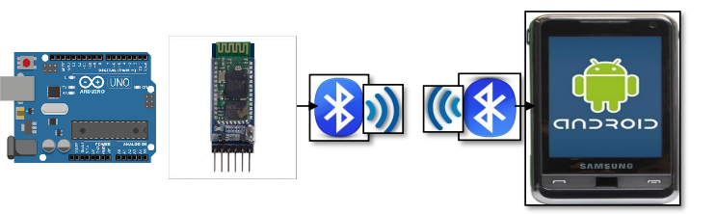
Bluetooth Methodology

Slide 11
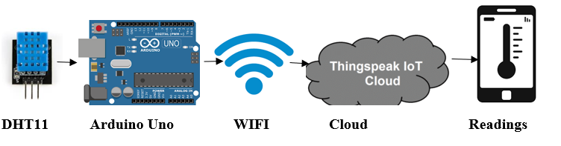
WIFI Methodology

Slide 12
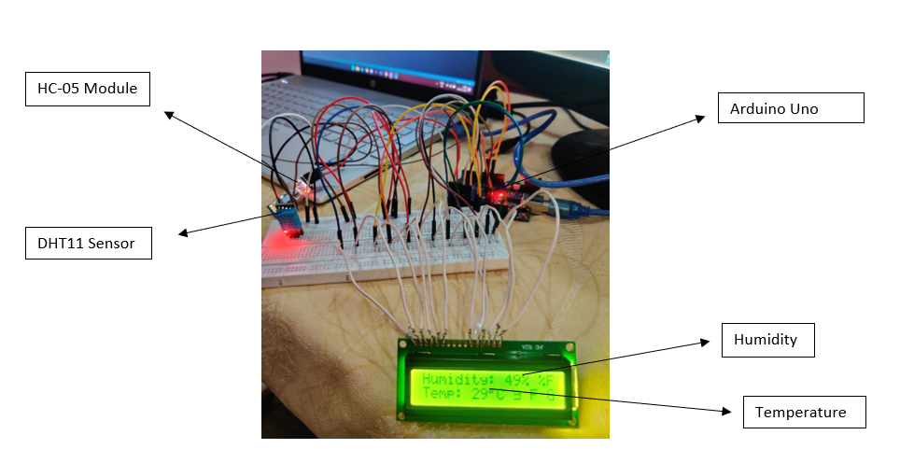
Hardware Bluetooth Representation

Slide 13
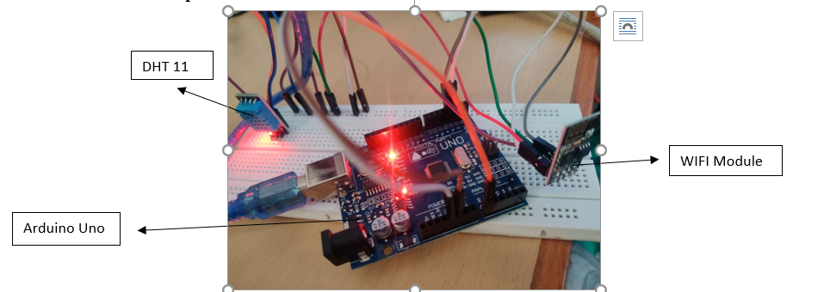
Hardware Wifi Representation

Slide 14
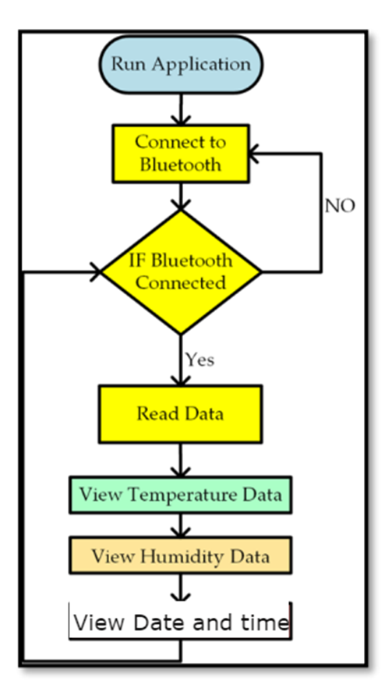
MIT App inventor

Slide 15
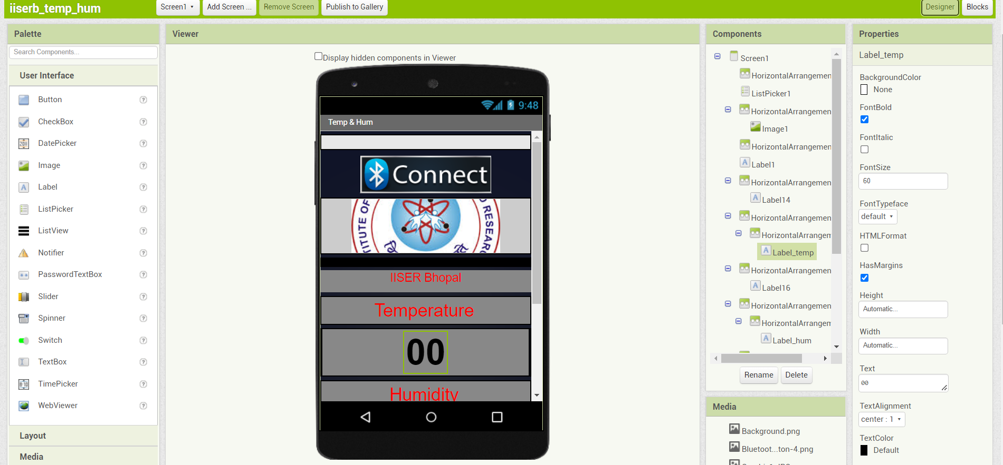
MIT App inventor

Slide 16
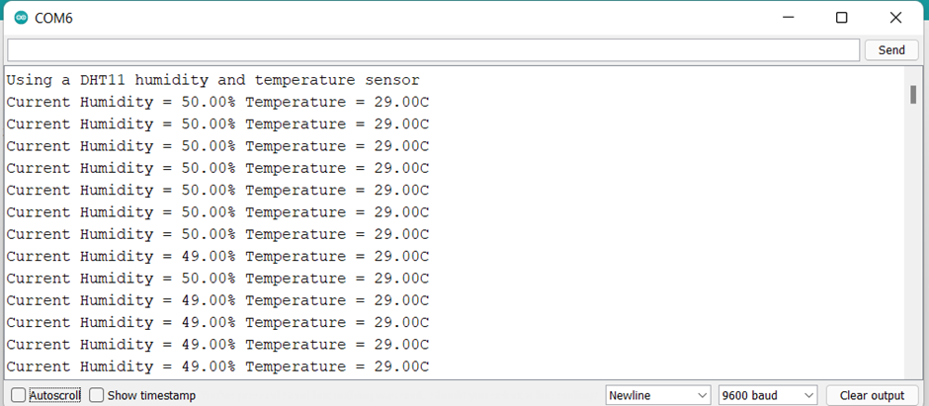
Results

Slide 17
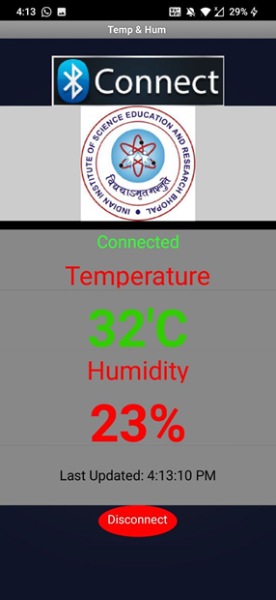
Results Of Android App

Slide 18
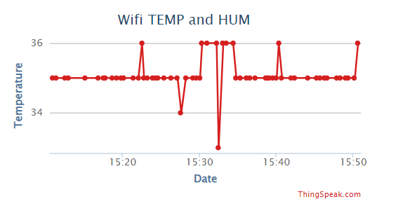
Graphical Record of Temperature Monitoring

Slide 19
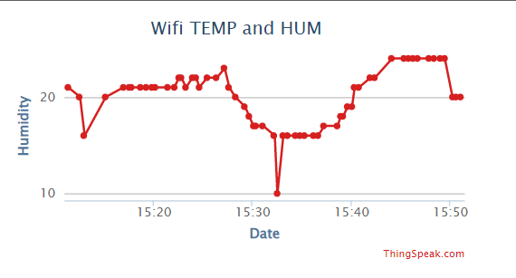
Graphical Record of Humidity Monitoring

Slide 20
References
[1]https://create.arduino.cc/projecthub/tehcwan_canel/temp-humidity-dht11-weather-monitoring-in-mobile-app-57b5ac
[2] https://www.mouser.com/datasheet/2/758/DHT11-Technical-Data-Sheet-Translated-Version-1143054.pdf
[3] https://iotdesignpro.com/projects/temperature-humidity-monitoring-over-thingspeak-using-arduino-esp8266
[4]https://www.researchgate.net/publication/352914267_On_the_Evaluation_of_DHT22_Temperature_Sensor_for_IoT_Application
[5] https://www.researchgate.net/publication/334207536_Humidity_and_temperature_monitoring
[6] https://www.academia.edu/download/58144752/IRJET-V5I12167.pdf
[7] http://ijrar.com/upload_issue/ijrar_issue_20543685.pdf
[8] https://link.springer.com/chapter/10.1007/978-981-15-6707-0_53

Slide 21
Thank You

